Slide 1

Data Representation
Text, Sound and Images
Source / Reference - https://youtu.be/tdmeXcDX-Uc
https://youtu.be/a3Y_ZvOr0K0
https://youtu.be/HlOTuCFtuV8

Slide 2
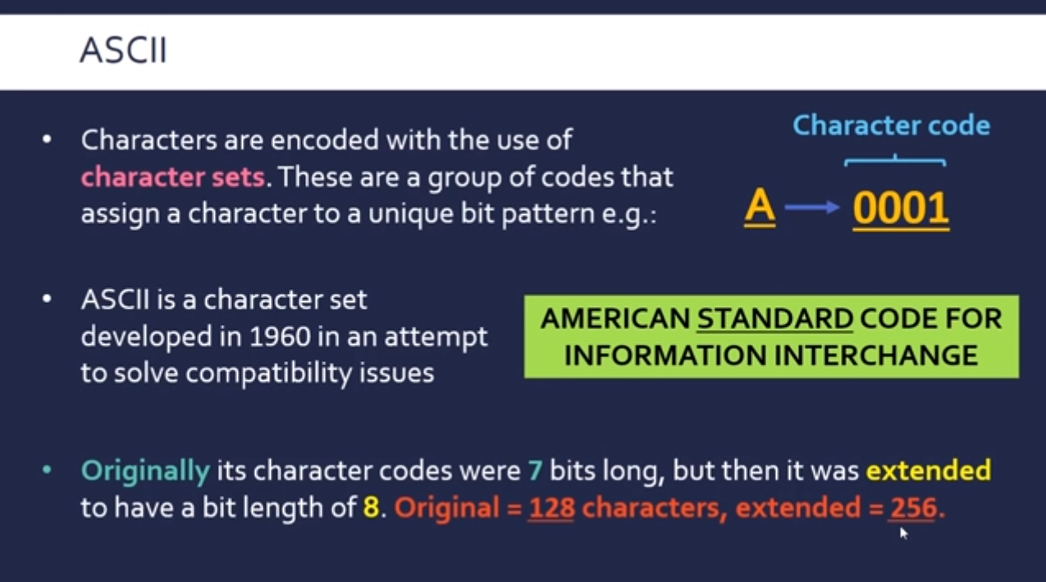

Slide 3
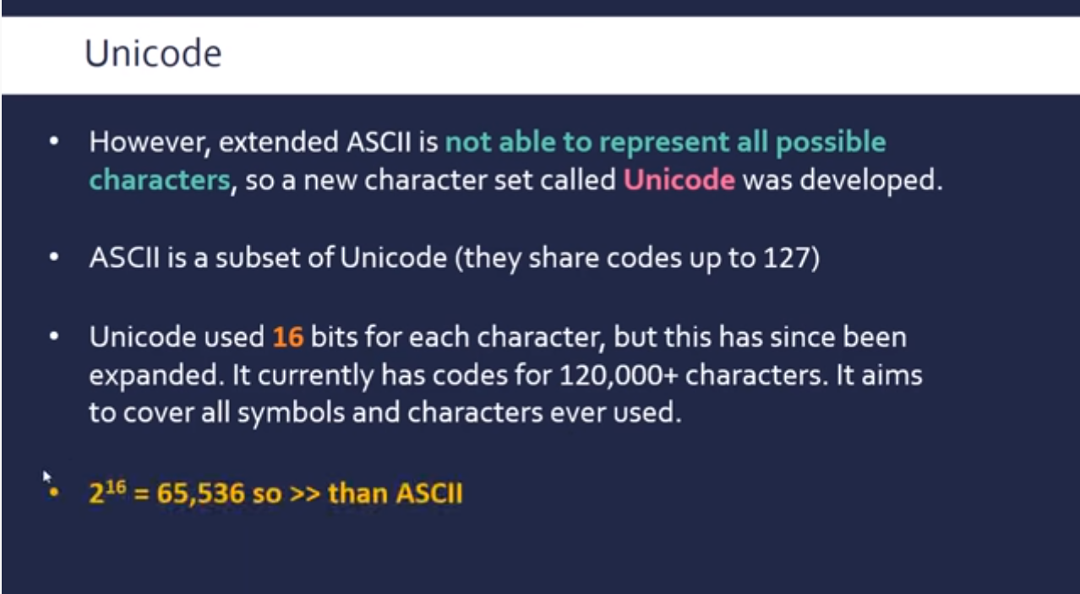

Slide 4
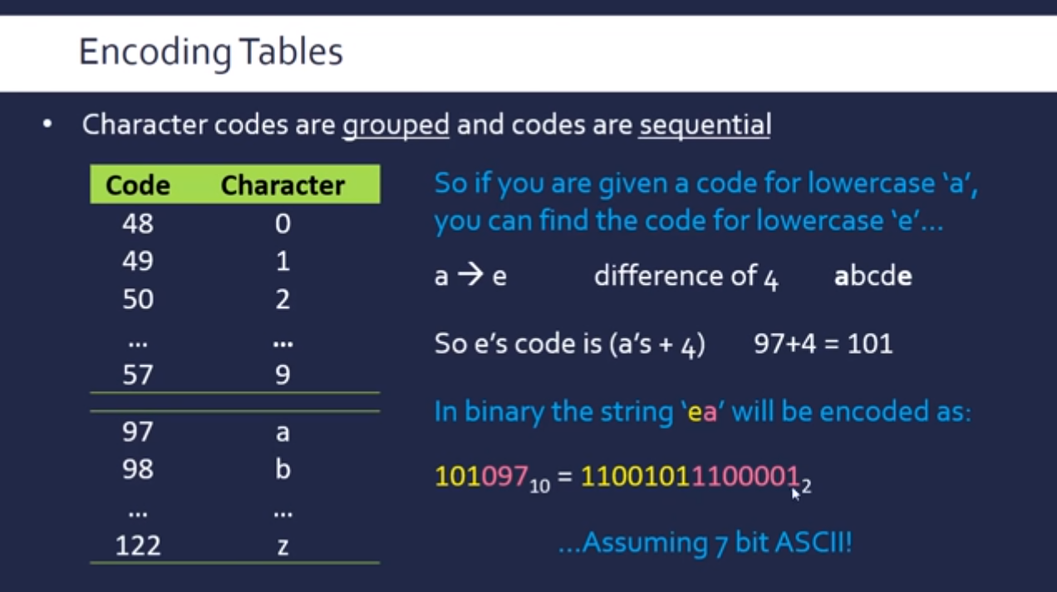

Slide 5
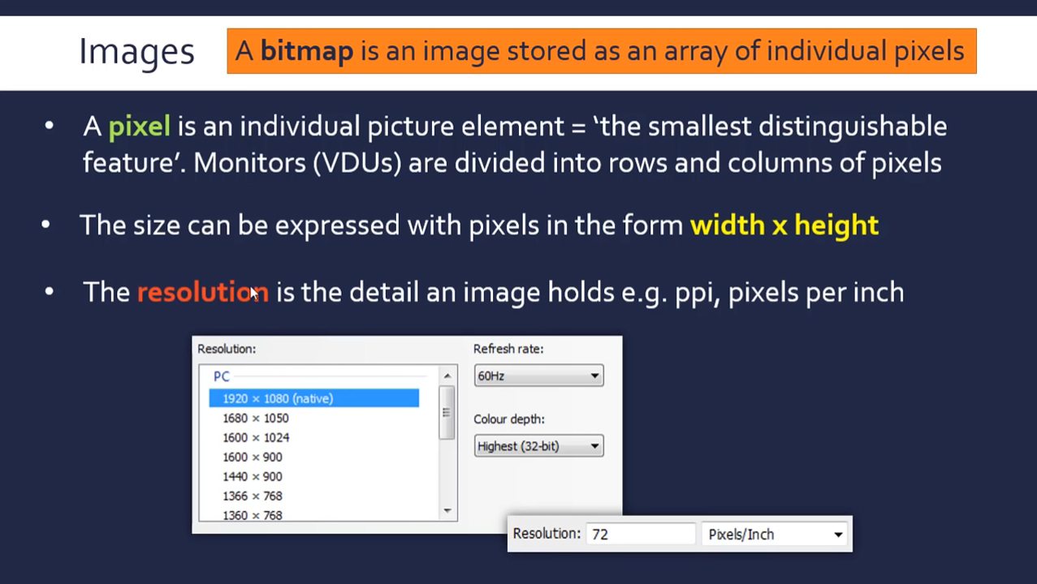

Slide 6
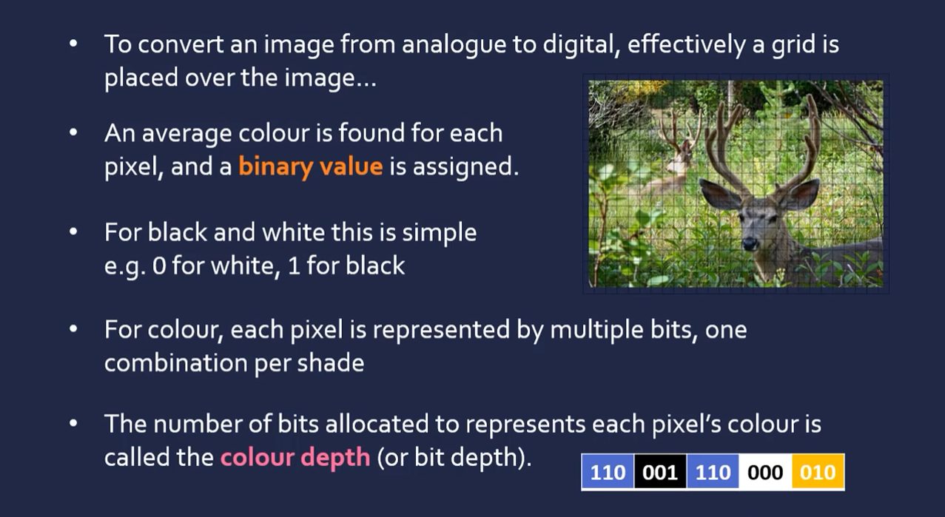

Slide 7
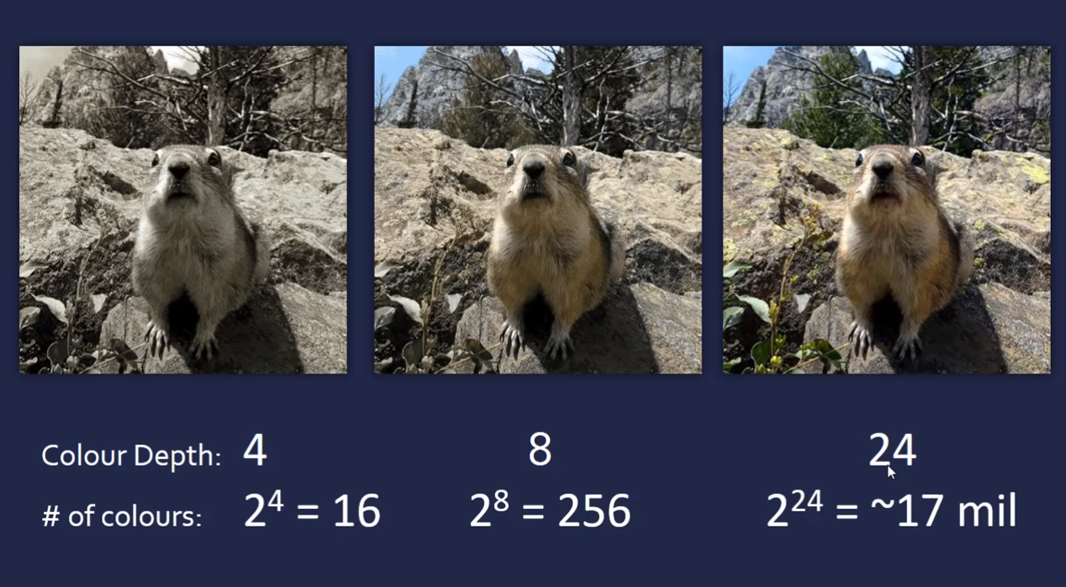

Slide 8
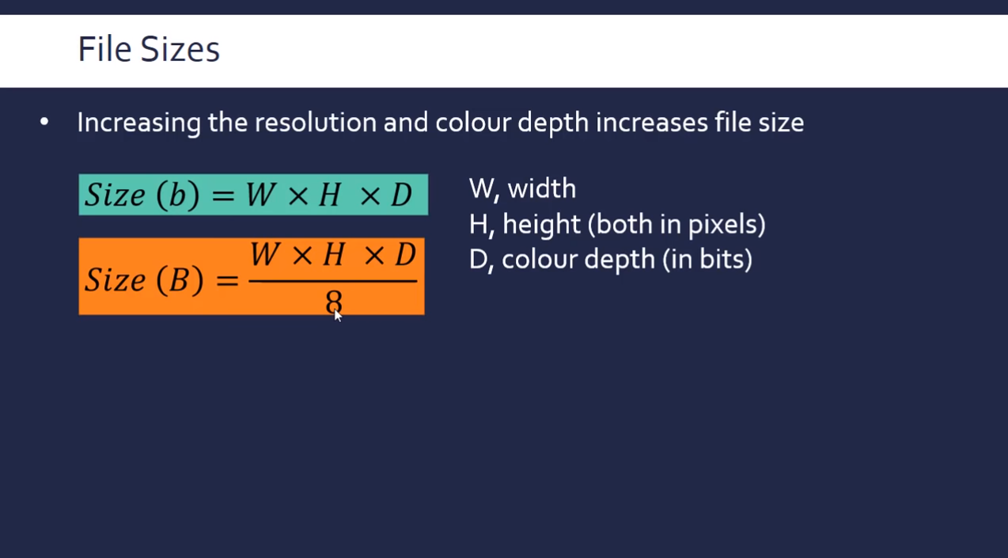

Slide 9
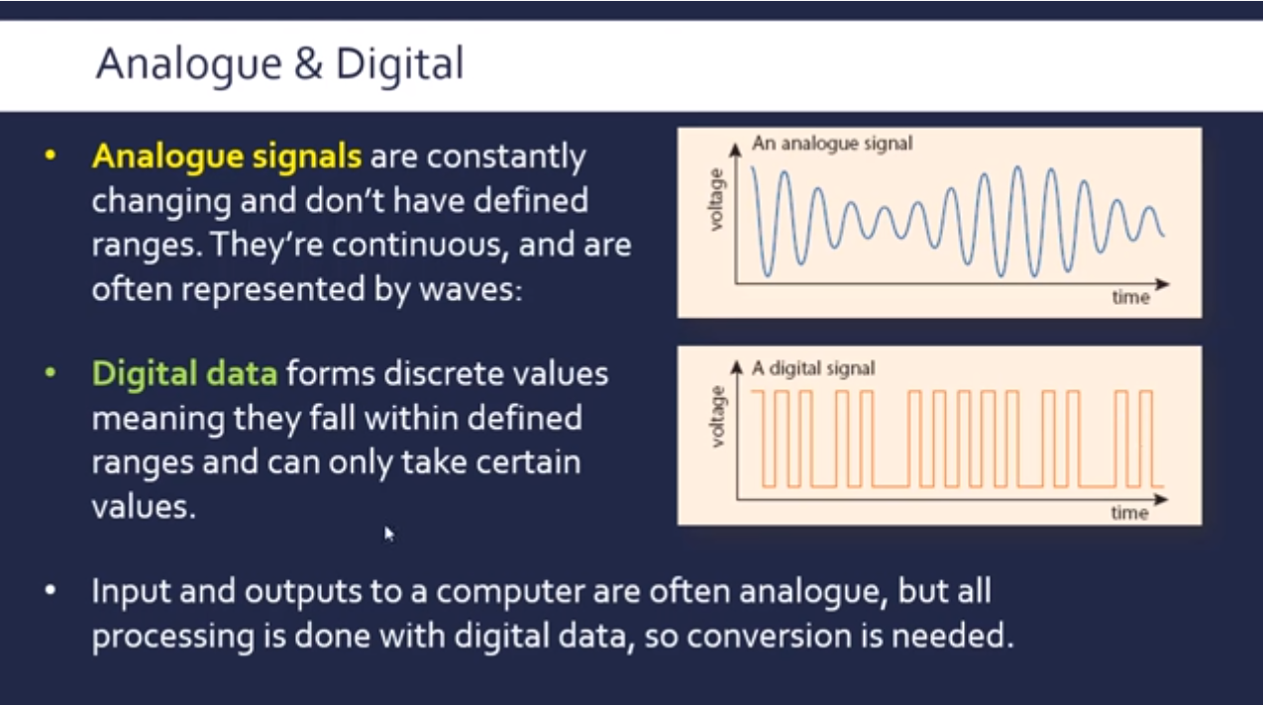

Slide 10
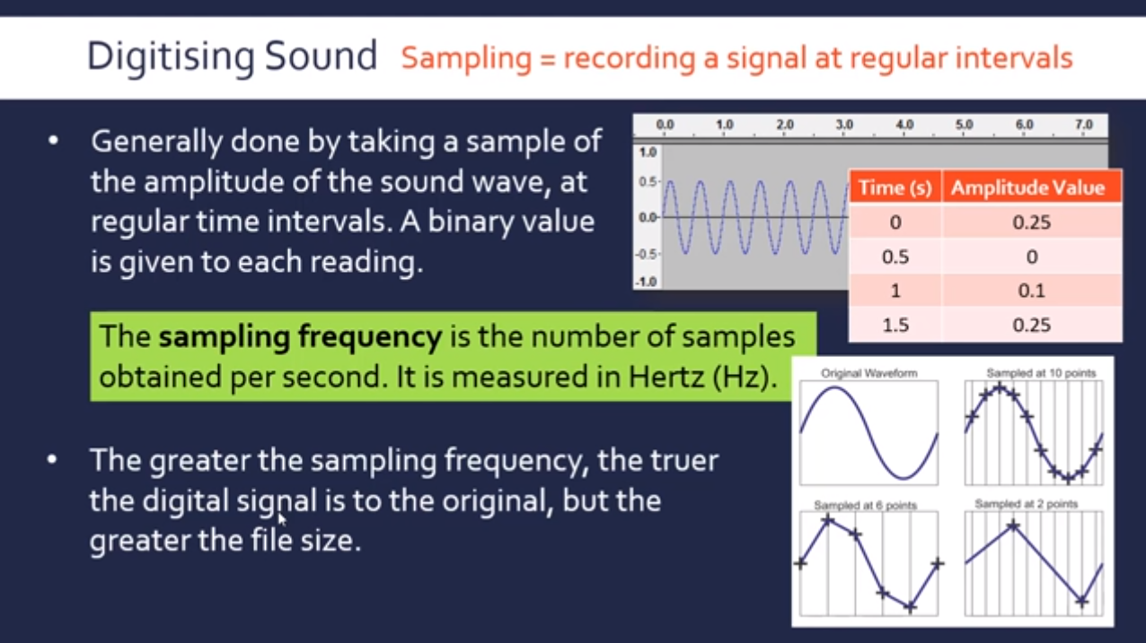

Slide 11
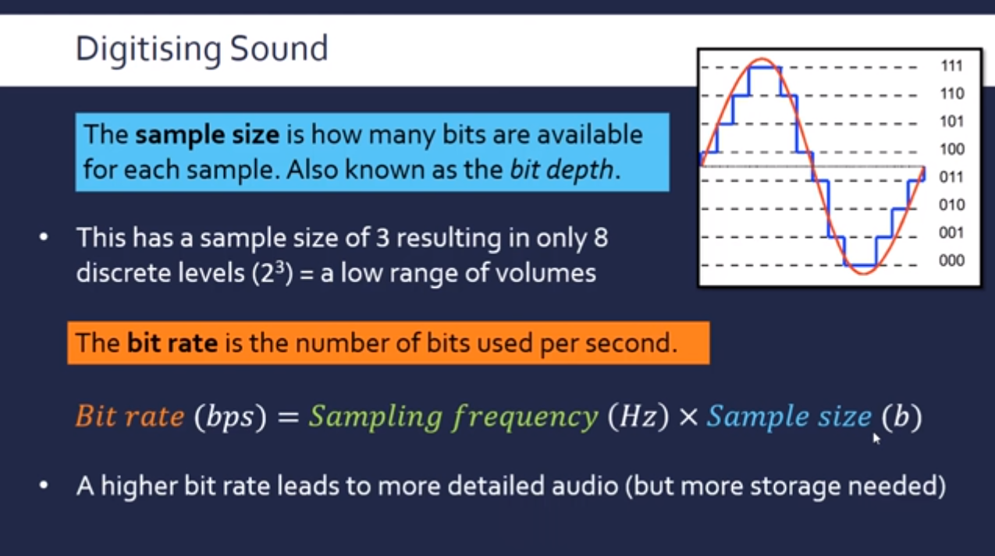

Slide 12
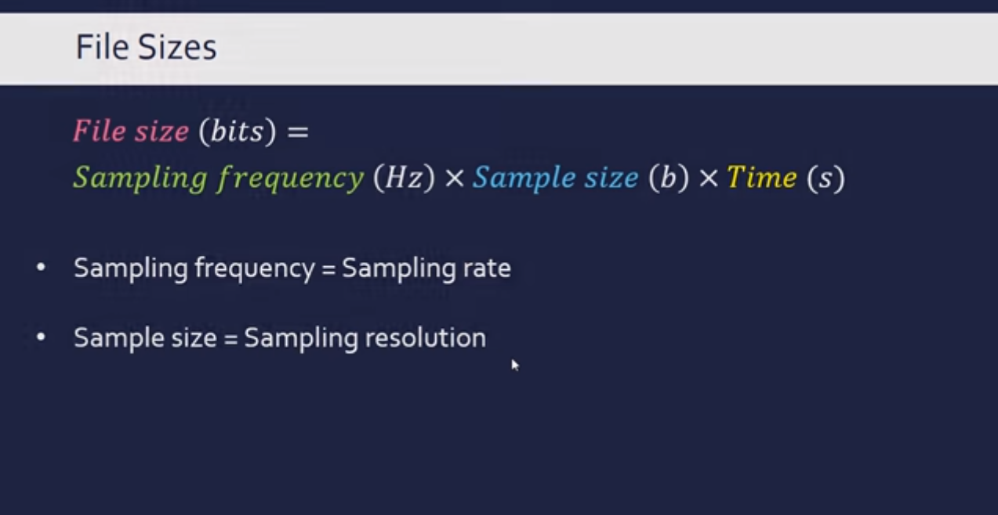

Slide 13
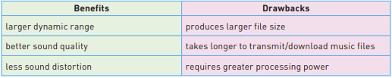
The benefits and drawbacks of using a larger sampling resolution when recording sound:

Slide 14
Quiz - https://forms.gle/P2ij8B6NYDmWz1Hc9

